Slide 1
Wynnum Bugs Scoreboard

Slide 2
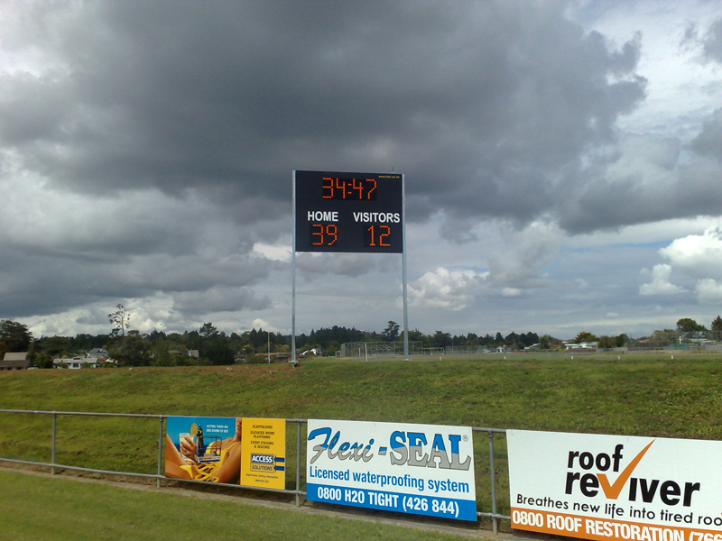
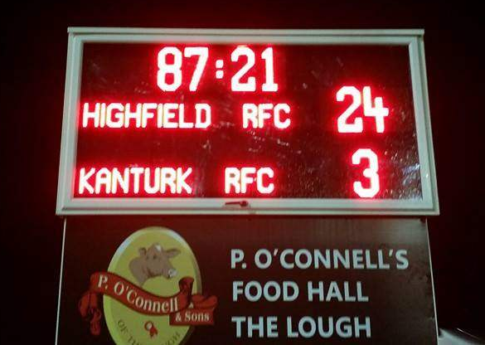
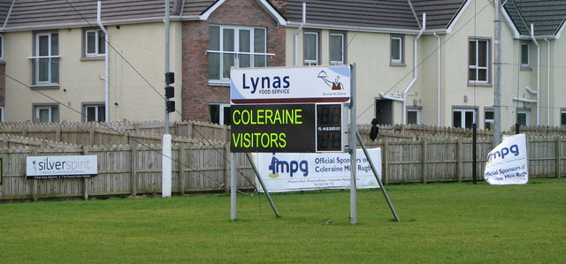
Fixed Mount
Permanent solution - just switch it on for games
Needs to be fully weatherproofed, tropicalised, vandal resistant, able to survive a football being booted into it
Preferably have ‘wing’ doors or a cover for the front (Brothers scoreboard has roller window storm shutter)
Allows a lot more options for signage, sponsorship, WIFI, etc
Fixed position (either clubhouse, far end, or toilet block)
Needs steel fabrication and building works – concrete footings and hot dipped galvanised frame
What’s the impact of re-doing the grounds in a year or two?
Would we need council approval?

Slide 3
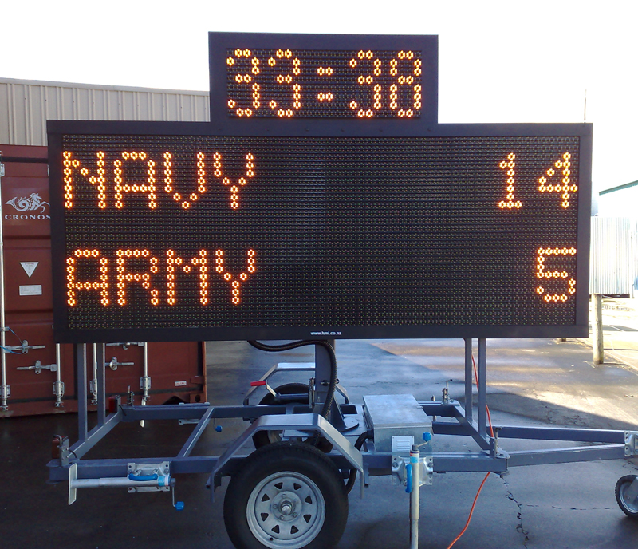
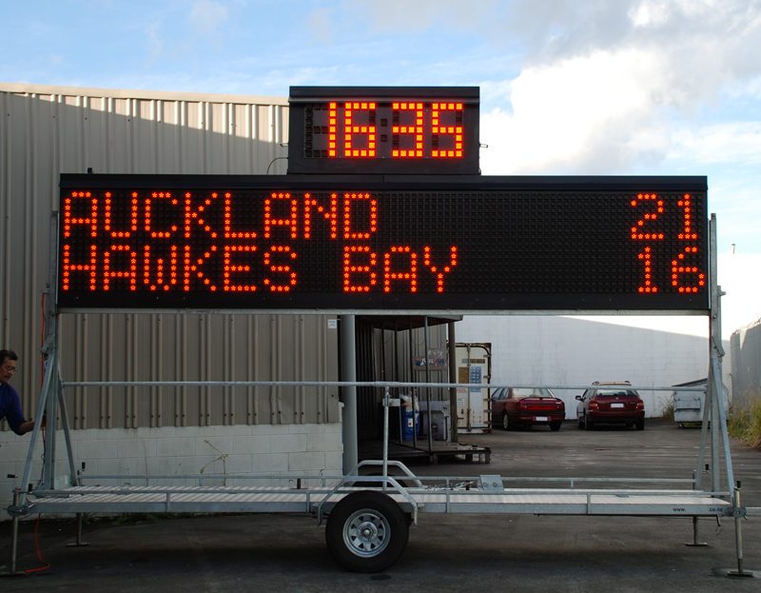
Mobile
Trailer mount is rugged / easy to fabricate / stable in high wind / some can be raised or lowered
A little larger to pull on field however can be fairly light weight / runs off a generator or 240VAC / showerproof
Could store in a 20’ shipping container until the new shed is done / easier to repair if it gets damaged
Don’t need to decide on a location (try out different places to see what works) / easy to add sponsorship signage

Slide 4
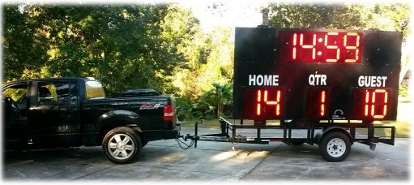
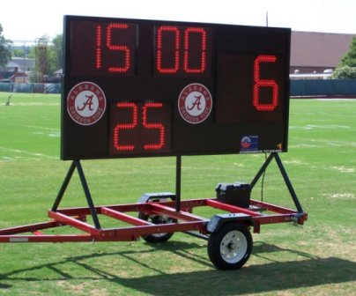
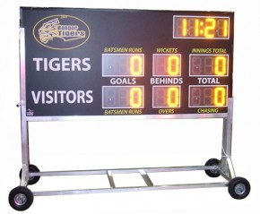
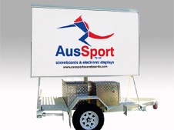

Slide 5
Electronics
Scoreboard
High brightness semi-outdoor or outdoor LED panels are easily sourced– can be red, blue, green white etc.
Two general designs:
full LED matrix (i.e. Wynnum RSL)
partial LED matrix (separate panels for team scores and timer)
Needs 240VAC power:
either on-field power outlet or generator
battery powered is more expensive, compromise on brightness vs battery life
Microprocessors, power supplies and support modules are generic and widely available off-the-shelf
Cost for scoreboard electronics (excluding all the physical mountings, backboards, trailer etc)
Full LED – electronic parts cost $5-10K+ depending on size
Partial LED – electronics parts cost <$1500 - see bill of materials
Controller
Needs to ‘just work’ and tough enough to survive rugby kids
Controls sent over 2.4GHz radio link – long range / resistant to noise / encrypted
Around $200 for parts and circuit board fabrication / proof of concept is running and works
Design files, schematics and source code to be all open sourced so can be maintained and modified
Looked at WIFI, Bluetooth for IPAD or Android:
a couple of challenges to overcome (range, battery life, integration issues)
more work to develop but could have live updates to website and twitter

Slide 6
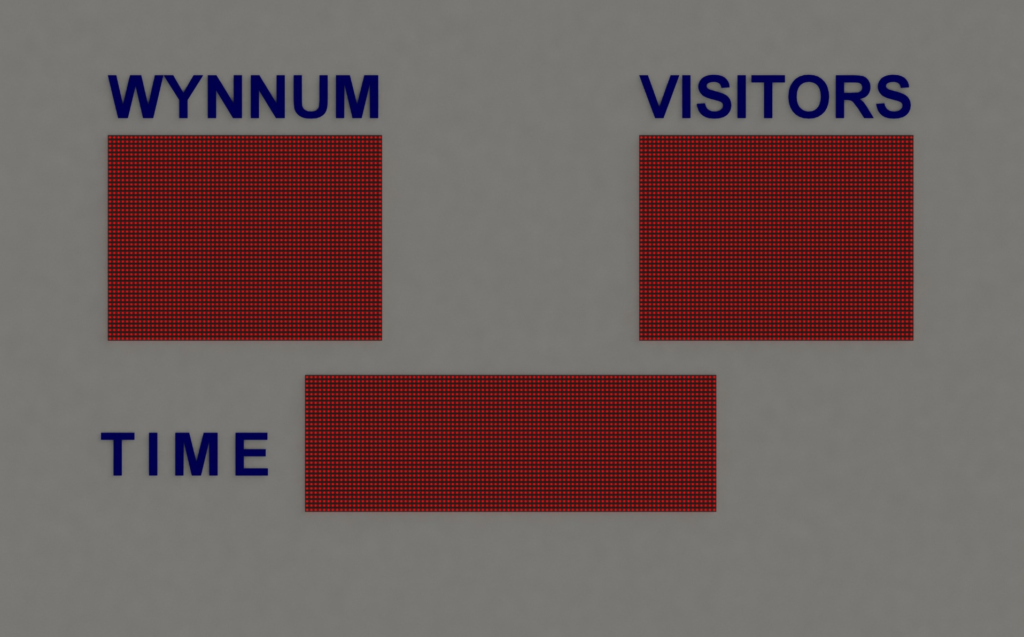


2500mm
1500mm
3 x groups of 6 x LED panels = 18 total ( 16 x 32 leds x 18 panels = 9K leds) – can be red, green, blue, white
3 x 30A 5V power supplies (peak current 72A@5V = 360 watts) – 2 fans for active cooling
4 x microcontrollers (1 x master and 3 x slave controllers) plus radio module
Backboards of aluminium-composite with polycarbonate impact cover over the LED’s

